Slide 1
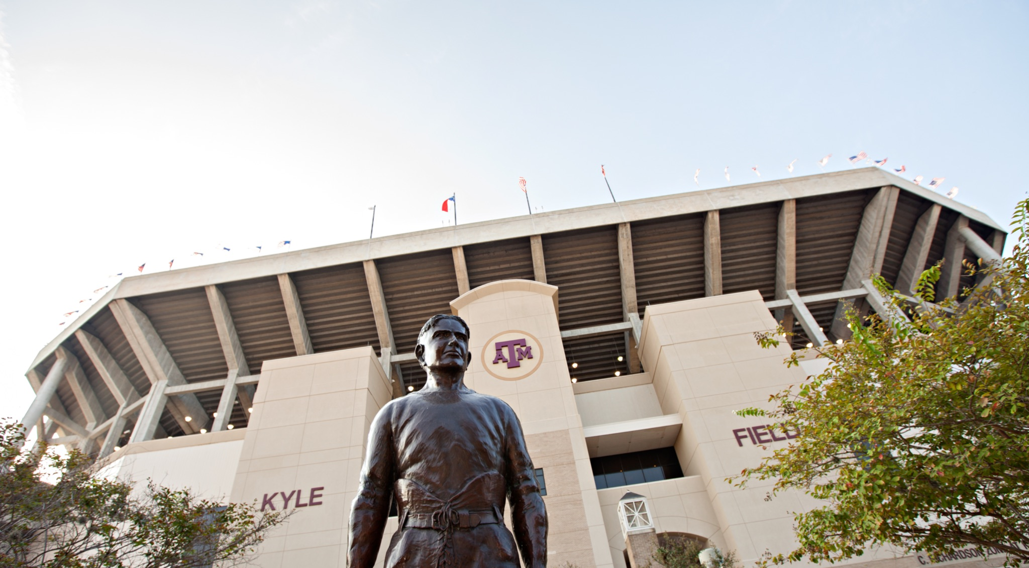

GitHub Actions Deploy an Azure Static Website

Slide 2
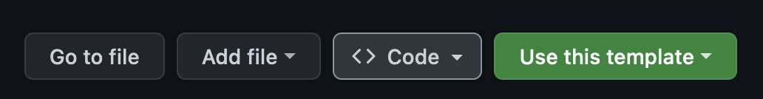
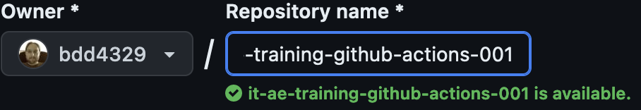
Lab 2 (create and clone repo)
Visit https://github.com/tamu-edu/it-ae-training-github-actions-001 in your web browser
Click “Use this template”:
Click “Create a new repository”
Change the owner to your NetID and use the name “it-ae-training-github-actions-001”:
Notes:
Introduce self
- Started as "AIP”: the Aggie Innovation Platform
- Our true goal was to reimagine and reinvent how enterprise IT was done at TAMU.
- And to influence the culture at TAMU to believe in processes with less toil, lower entropy, and higher efficiency.
- And we all really love robots.
For most of TAMU, we are the “service owner” of the Public Clouds.

Slide 3
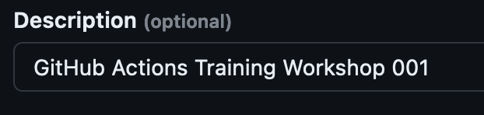
Lab 2 (create and clone repo)
Add a useful description
Click ”Create Repository” (this will take you to the new repository)
Clone the repository locally using either “GitHub Desktop” button or the CLI
Notes:
Introduce self
- Started as "AIP”: the Aggie Innovation Platform
- Our true goal was to reimagine and reinvent how enterprise IT was done at TAMU.
- And to influence the culture at TAMU to believe in processes with less toil, lower entropy, and higher efficiency.
- And we all really love robots.
For most of TAMU, we are the “service owner” of the Public Clouds.

Slide 4
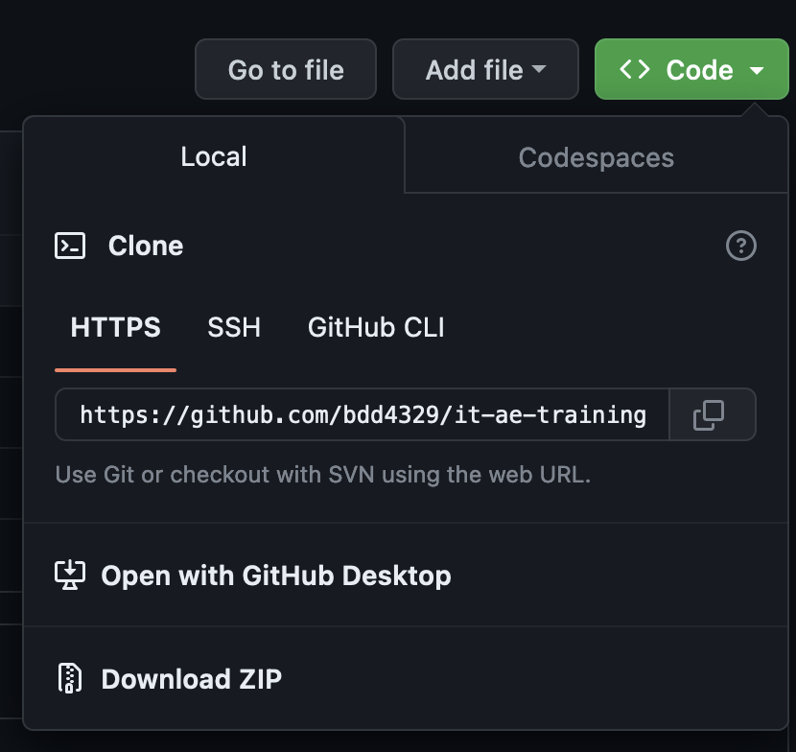
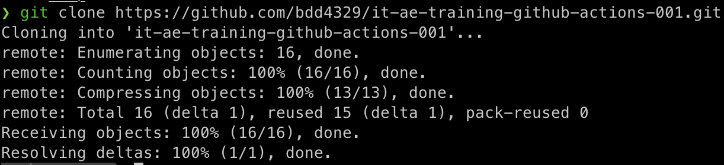
Lab 2 (create and clone repo)
Click “Open with GitHub Desktop” or
use “git clone”
Notes:
Introduce self
- Started as "AIP”: the Aggie Innovation Platform
- Our true goal was to reimagine and reinvent how enterprise IT was done at TAMU.
- And to influence the culture at TAMU to believe in processes with less toil, lower entropy, and higher efficiency.
- And we all really love robots.
For most of TAMU, we are the “service owner” of the Public Clouds.

Slide 5
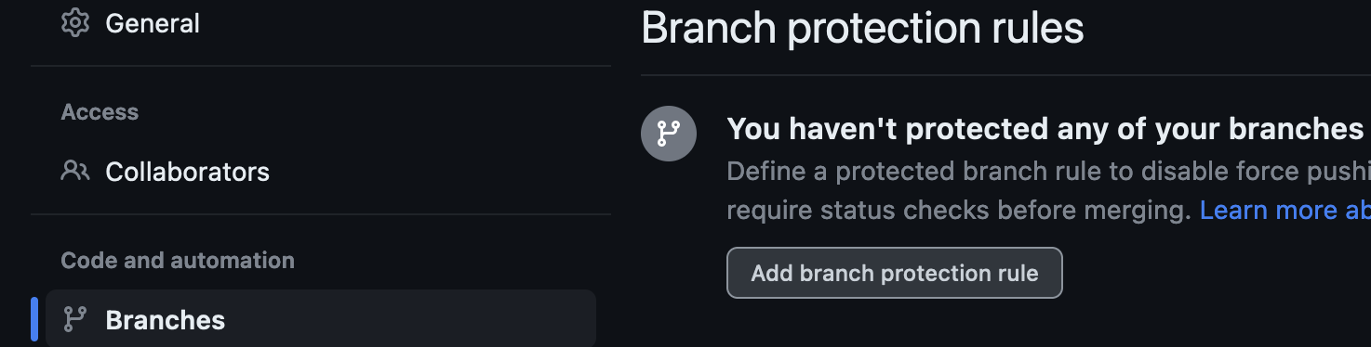

Lab 2 (add branch protection rules)
1. Go to the “Settings” tab at the top of your repo
Go to “Branches” on the left and click “Add branch protection rule”
Enter “main” for the “Branch name pattern” and check the following:
1. Require a pull request before merging (check)
2. Require approvals (uncheck)
Click “Create”
Notes:
Introduce self
- Started as "AIP”: the Aggie Innovation Platform
- Our true goal was to reimagine and reinvent how enterprise IT was done at TAMU.
- And to influence the culture at TAMU to believe in processes with less toil, lower entropy, and higher efficiency.
- And we all really love robots.
For most of TAMU, we are the “service owner” of the Public Clouds.

Slide 6
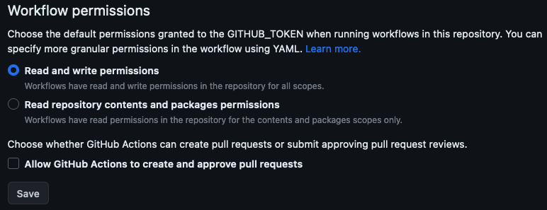
Lab 2 (change Actions permissions)
Go to the “Settings” tab at the top of your repo
Go to “Actions” > “General” on the left and change the “Workflow permissions” to “Read and write permissions” and click “Save”
Notes:
Introduce self
- Started as "AIP”: the Aggie Innovation Platform
- Our true goal was to reimagine and reinvent how enterprise IT was done at TAMU.
- And to influence the culture at TAMU to believe in processes with less toil, lower entropy, and higher efficiency.
- And we all really love robots.
For most of TAMU, we are the “service owner” of the Public Clouds.

Slide 7
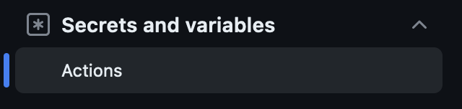

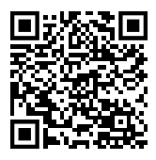
Lab 2 (add GitHub Actions secrets)
Go to the “Settings” tab at the top of your repo
Go to “Secrets and variables” > “Actions” on the left menu
Use the “New repository secret” button to add two secrets:
NETID – Set this to your NetID in all lowercase (replace any “_” or “.” characters with a “-”)
AZURE_AD_CLIENT_SECRET – Set this to the password value from the following 1password link:
Notes:
Introduce self
- Started as "AIP”: the Aggie Innovation Platform
- Our true goal was to reimagine and reinvent how enterprise IT was done at TAMU.
- And to influence the culture at TAMU to believe in processes with less toil, lower entropy, and higher efficiency.
- And we all really love robots.
For most of TAMU, we are the “service owner” of the Public Clouds.

Slide 8
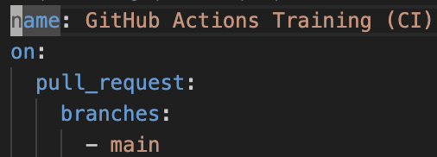
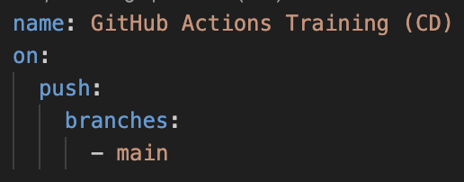
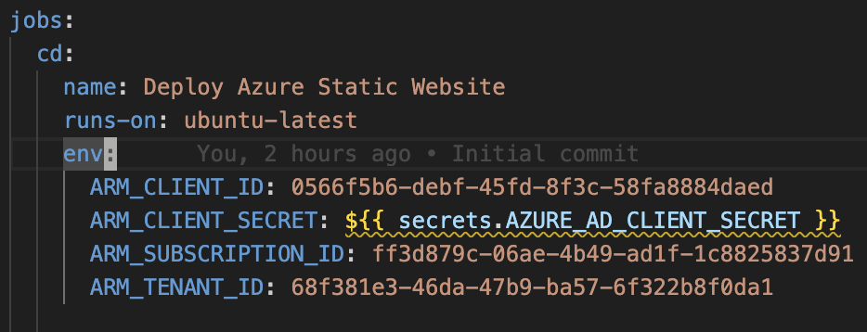
Lab 2 (investigate the workflow)
Look at the code you’ve checked out locally
.github/workflows/ci.yaml
.github/workflows/cd.yaml
Observe the trigger for each of the two files:
Notice the job setup + environment variables:
Notes:
Introduce self
- Started as "AIP”: the Aggie Innovation Platform
- Our true goal was to reimagine and reinvent how enterprise IT was done at TAMU.
- And to influence the culture at TAMU to believe in processes with less toil, lower entropy, and higher efficiency.
- And we all really love robots.
For most of TAMU, we are the “service owner” of the Public Clouds.

Slide 9
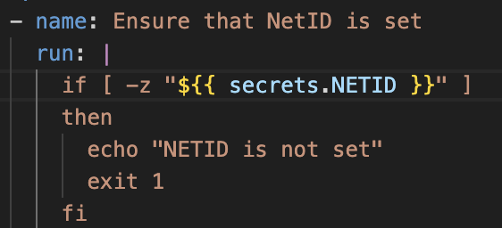
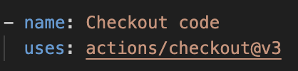
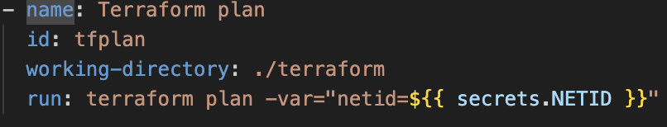
Lab 2 (investigate the workflow)
See how we can run a simple shell script
Look at how we checkout the code
Notice the use of terraform plan to preview changes (in ci.yaml)
Notes:
Introduce self
- Started as "AIP”: the Aggie Innovation Platform
- Our true goal was to reimagine and reinvent how enterprise IT was done at TAMU.
- And to influence the culture at TAMU to believe in processes with less toil, lower entropy, and higher efficiency.
- And we all really love robots.
For most of TAMU, we are the “service owner” of the Public Clouds.

Slide 10
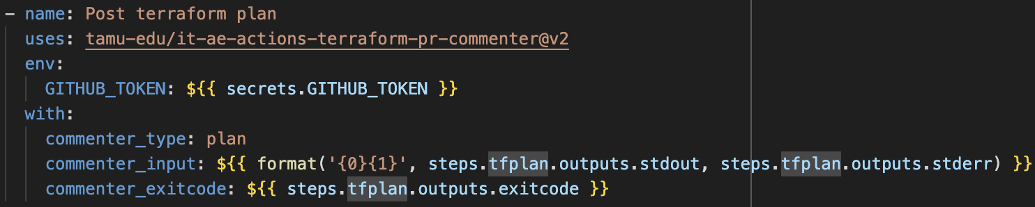
Lab 2 (investigate the workflow)
See how we can post the terraform plan result to the Pull Request as a comment
Notes:
Introduce self
- Started as "AIP”: the Aggie Innovation Platform
- Our true goal was to reimagine and reinvent how enterprise IT was done at TAMU.
- And to influence the culture at TAMU to believe in processes with less toil, lower entropy, and higher efficiency.
- And we all really love robots.
For most of TAMU, we are the “service owner” of the Public Clouds.

Slide 11
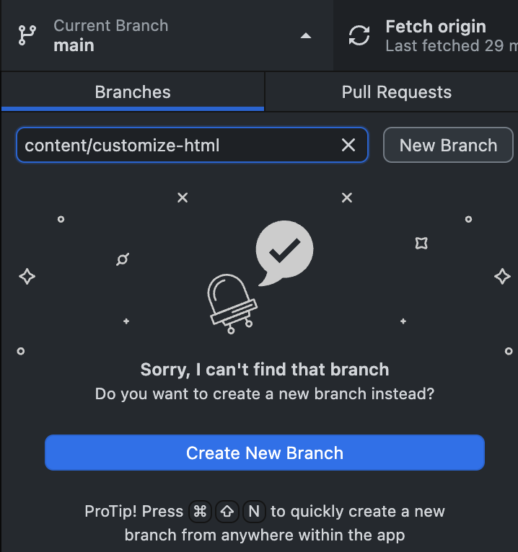
Lab 2 (create a new branch)
Create a new branch using either GitHub Desktop or the CLI called “content/customize-html”
or
Notes:
Introduce self
- Started as "AIP”: the Aggie Innovation Platform
- Our true goal was to reimagine and reinvent how enterprise IT was done at TAMU.
- And to influence the culture at TAMU to believe in processes with less toil, lower entropy, and higher efficiency.
- And we all really love robots.
For most of TAMU, we are the “service owner” of the Public Clouds.

Slide 12
Lab 2 (customize HTML content)
Modify the index.html and the 404.html in the “web_content” directory. Ensure that the result is still valid HTML (you can check via your browser locally)
Notes:
Introduce self
- Started as "AIP”: the Aggie Innovation Platform
- Our true goal was to reimagine and reinvent how enterprise IT was done at TAMU.
- And to influence the culture at TAMU to believe in processes with less toil, lower entropy, and higher efficiency.
- And we all really love robots.
For most of TAMU, we are the “service owner” of the Public Clouds.

Slide 13
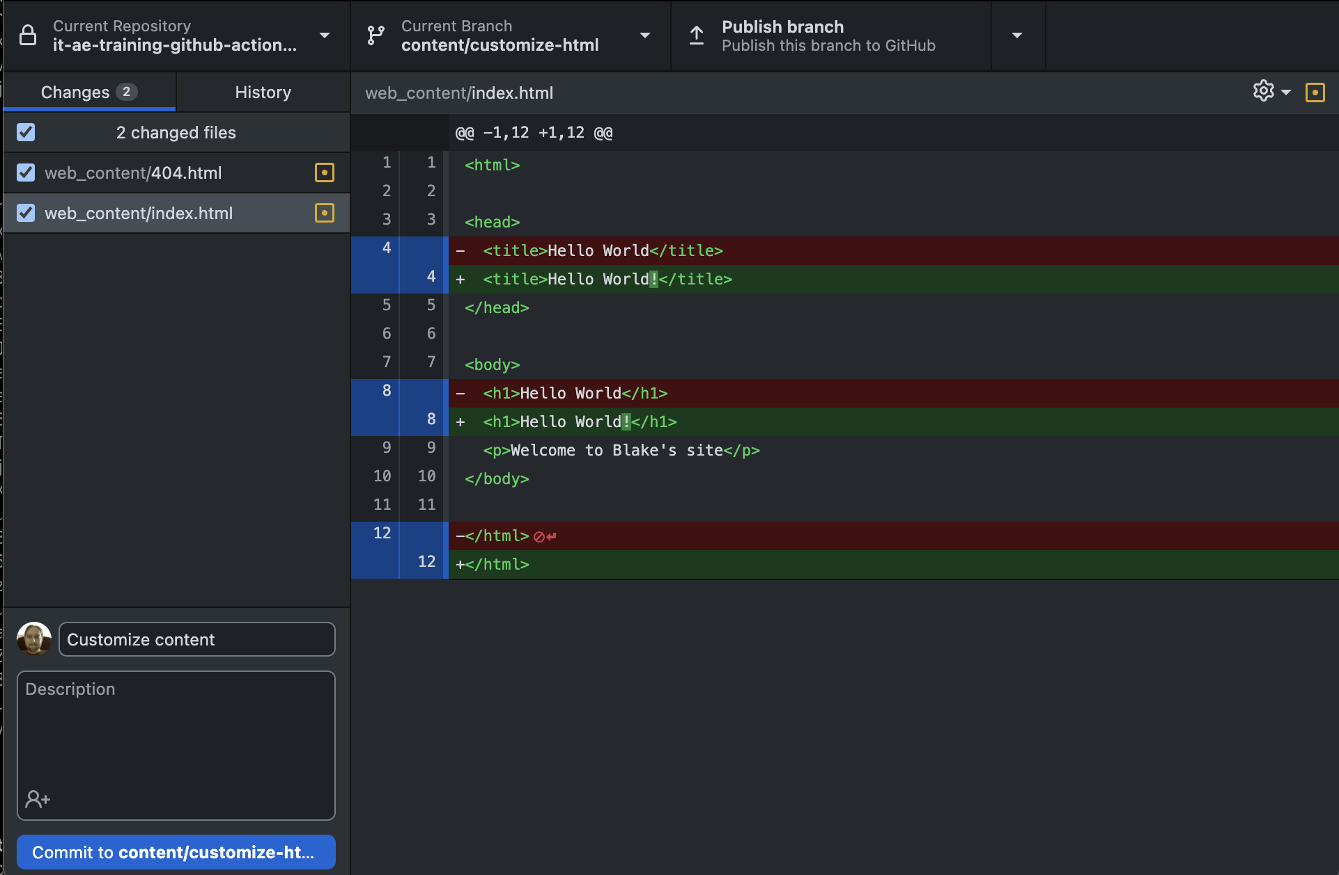
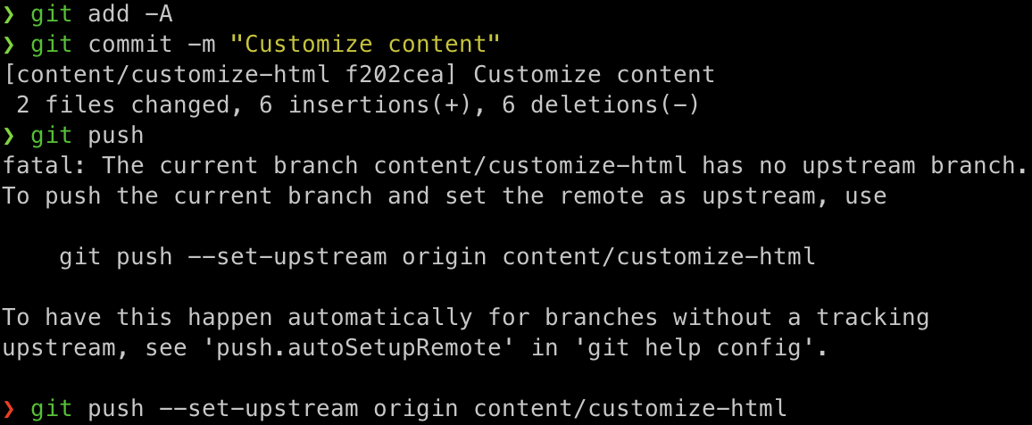
Lab 2 (check in your content)
Check in and push the modified content (which will use your new branch) via GitHub Desktop or the CLI
or
Notes:
Introduce self
- Started as "AIP”: the Aggie Innovation Platform
- Our true goal was to reimagine and reinvent how enterprise IT was done at TAMU.
- And to influence the culture at TAMU to believe in processes with less toil, lower entropy, and higher efficiency.
- And we all really love robots.
For most of TAMU, we are the “service owner” of the Public Clouds.

Slide 14
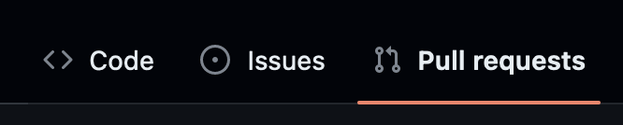
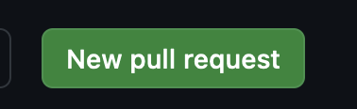

Lab 2 (create a PR)
Go to your github.com repo in your web browser and create a new PR against the “main” branch using your new branch
Make sure that you are requesting to merge your new branch into main
Create the PR
Do NOT immediately merge
Notes:
Introduce self
- Started as "AIP”: the Aggie Innovation Platform
- Our true goal was to reimagine and reinvent how enterprise IT was done at TAMU.
- And to influence the culture at TAMU to believe in processes with less toil, lower entropy, and higher efficiency.
- And we all really love robots.
For most of TAMU, we are the “service owner” of the Public Clouds.

Slide 15
Lab 2 (investigate the Action run)
Go see the Actions run result by going to “Actions” at the top of the page
Investigate the “Terraform plan” step
Notes:
Introduce self
- Started as "AIP”: the Aggie Innovation Platform
- Our true goal was to reimagine and reinvent how enterprise IT was done at TAMU.
- And to influence the culture at TAMU to believe in processes with less toil, lower entropy, and higher efficiency.
- And we all really love robots.
For most of TAMU, we are the “service owner” of the Public Clouds.

Slide 16
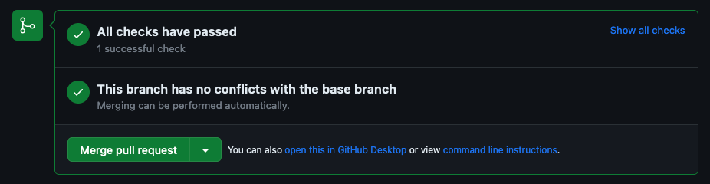

Lab 2 (merge the PR)
Merge the Pull Request
Investigate the Action run that deploys the site
Notes:
Introduce self
- Started as "AIP”: the Aggie Innovation Platform
- Our true goal was to reimagine and reinvent how enterprise IT was done at TAMU.
- And to influence the culture at TAMU to believe in processes with less toil, lower entropy, and higher efficiency.
- And we all really love robots.
For most of TAMU, we are the “service owner” of the Public Clouds.

Slide 17
Lab 2 (visit your website)
Look at the Action run “Terraform apply” step to find the website URL: https://tamughtrnbdd4329.z21.web.core.windows.net/
Visit the URL to view your website. NOTE: because of the way we handled the NetID via an Actions secret, you’ll have to replace “***” with your NetID in the URL
Notes:
Introduce self
- Started as "AIP”: the Aggie Innovation Platform
- Our true goal was to reimagine and reinvent how enterprise IT was done at TAMU.
- And to influence the culture at TAMU to believe in processes with less toil, lower entropy, and higher efficiency.
- And we all really love robots.
For most of TAMU, we are the “service owner” of the Public Clouds.

Slide 18
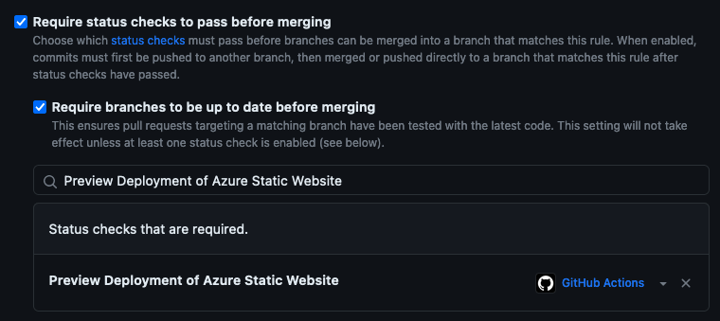

Lab 2 (update branch protection)
Go back to your github.com repo in your browser and go to “Settings” and then “Branches”
Update the branch protection for “main” to “Require status checks to pass before merging” and “Require branches to be up to date before merging”. Add “Preview Deployment of Azure Static Websites” to the required status checks and ”save changes”
Notes:
Introduce self
- Started as "AIP”: the Aggie Innovation Platform
- Our true goal was to reimagine and reinvent how enterprise IT was done at TAMU.
- And to influence the culture at TAMU to believe in processes with less toil, lower entropy, and higher efficiency.
- And we all really love robots.
For most of TAMU, we are the “service owner” of the Public Clouds.

Slide 19
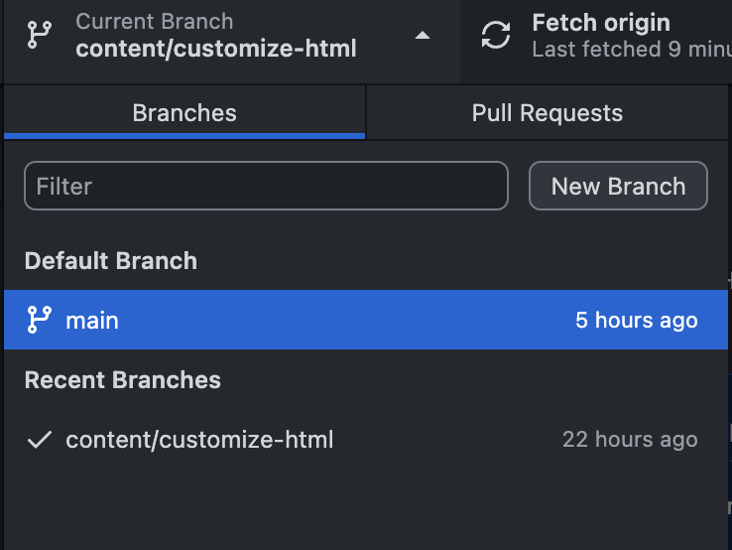
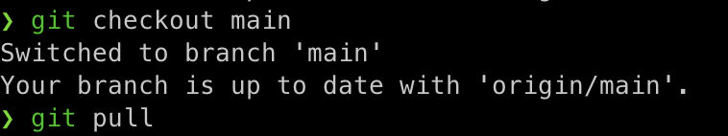

Lab 2 (switch to main branch and fetch)
Switch back to your “main” branch and fetch the latest changes
or
Notes:
Introduce self
- Started as "AIP”: the Aggie Innovation Platform
- Our true goal was to reimagine and reinvent how enterprise IT was done at TAMU.
- And to influence the culture at TAMU to believe in processes with less toil, lower entropy, and higher efficiency.
- And we all really love robots.
For most of TAMU, we are the “service owner” of the Public Clouds.

Slide 20
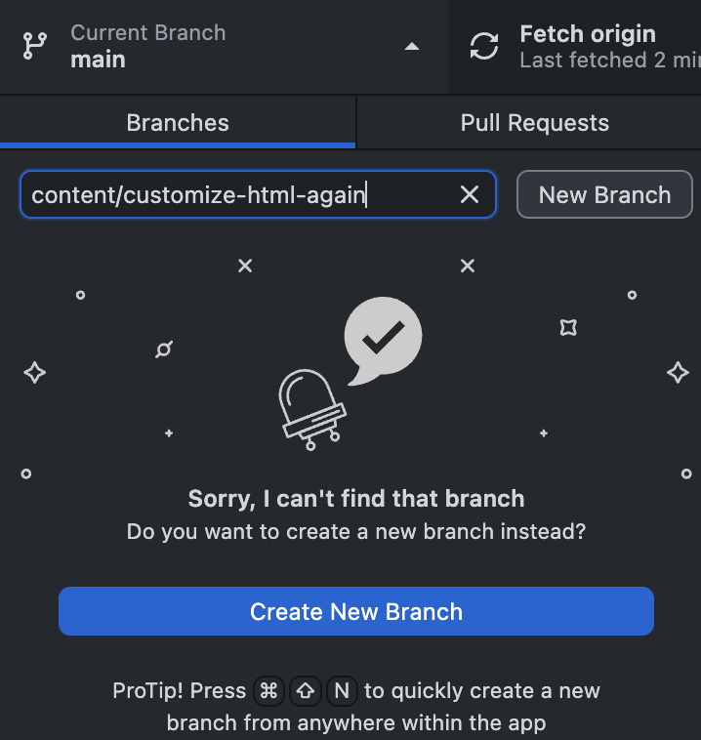
Lab 2 (create a new branch)
Create a new branch using either GitHub Desktop or the CLI called “content/customize-html-again”
NOTE: The branch should be named something different than your first branch name
or
Notes:
Introduce self
- Started as "AIP”: the Aggie Innovation Platform
- Our true goal was to reimagine and reinvent how enterprise IT was done at TAMU.
- And to influence the culture at TAMU to believe in processes with less toil, lower entropy, and higher efficiency.
- And we all really love robots.
For most of TAMU, we are the “service owner” of the Public Clouds.

Slide 21
Lab 2 (change HTML content)
Modify the index.html in the “web_content” directory. Ensure that the result is still valid HTML (you can check via your browser locally)
Notes:
Introduce self
- Started as "AIP”: the Aggie Innovation Platform
- Our true goal was to reimagine and reinvent how enterprise IT was done at TAMU.
- And to influence the culture at TAMU to believe in processes with less toil, lower entropy, and higher efficiency.
- And we all really love robots.
For most of TAMU, we are the “service owner” of the Public Clouds.

Slide 22
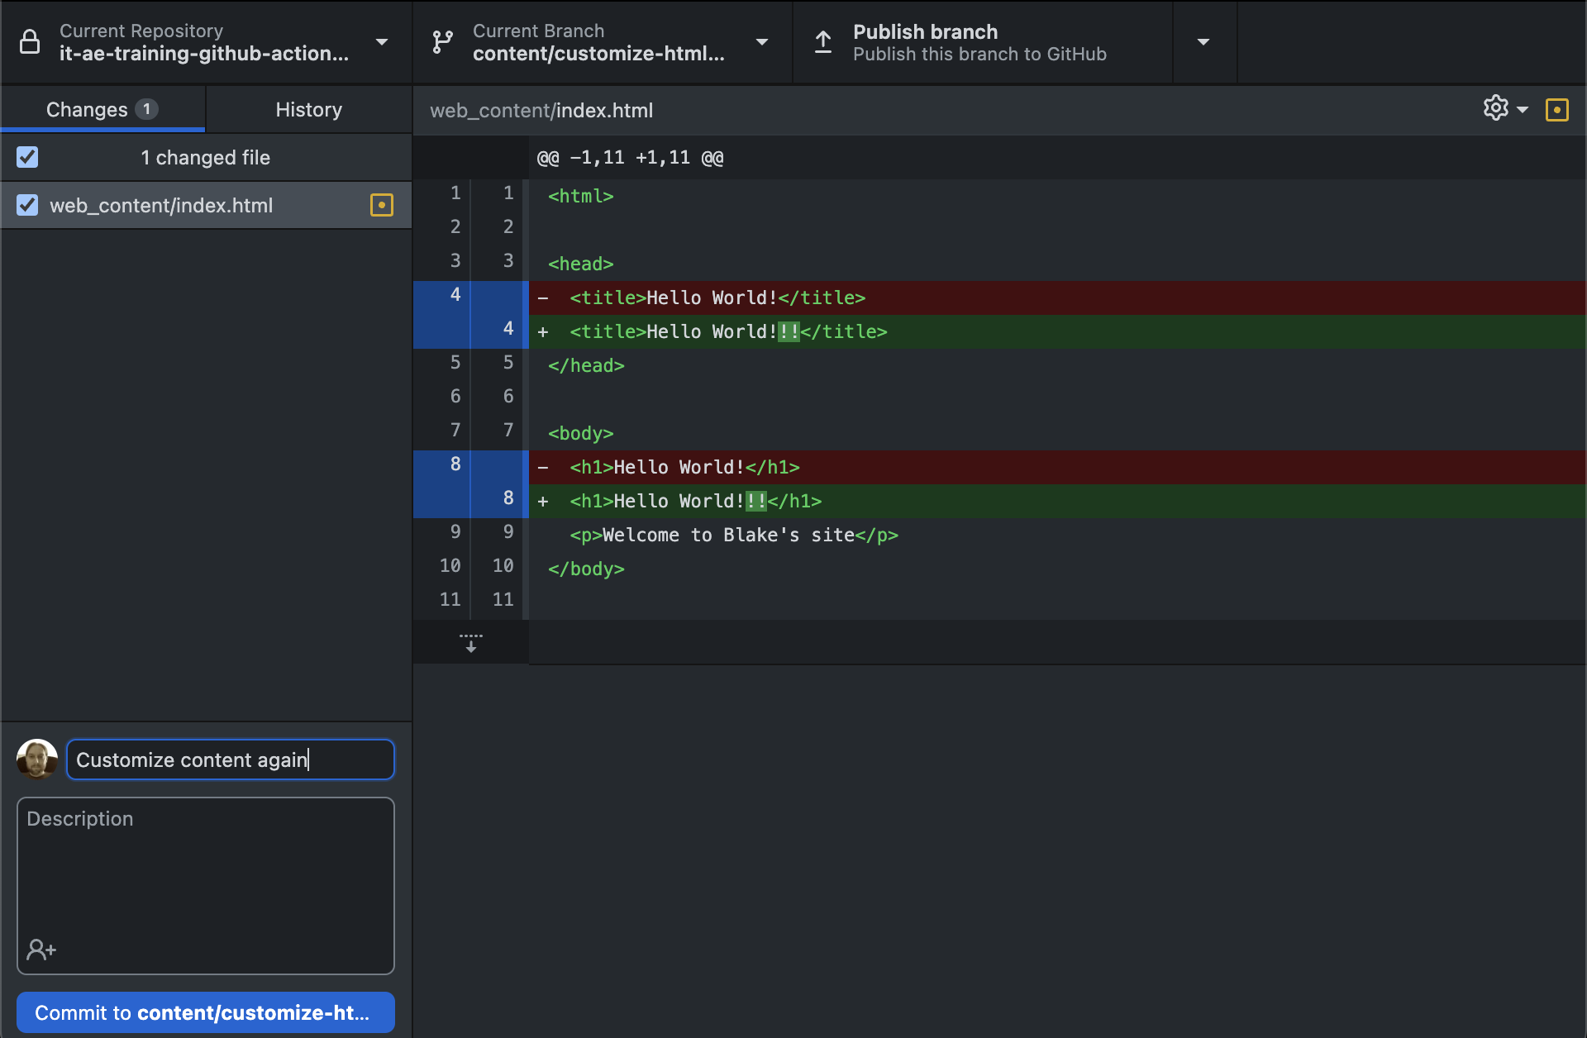
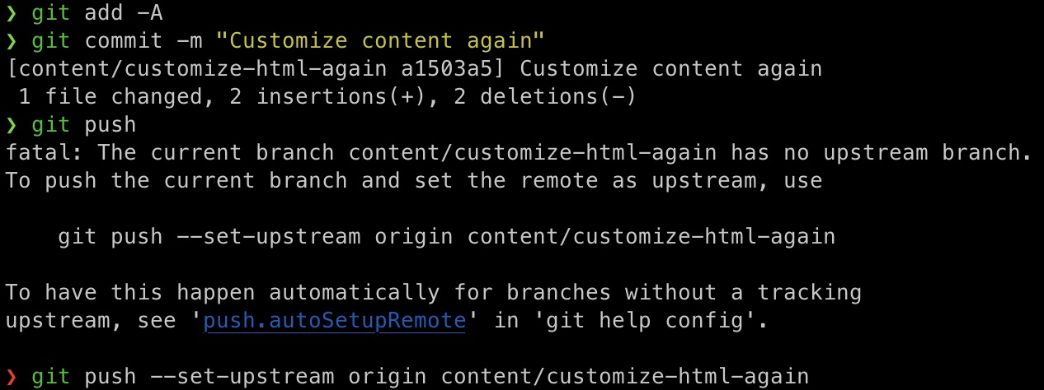
Lab 2 (check in your content)
Check in and push/publish the modified content (which will use your new branch) via GitHub Desktop or the CLI
or
Notes:
Introduce self
- Started as "AIP”: the Aggie Innovation Platform
- Our true goal was to reimagine and reinvent how enterprise IT was done at TAMU.
- And to influence the culture at TAMU to believe in processes with less toil, lower entropy, and higher efficiency.
- And we all really love robots.
For most of TAMU, we are the “service owner” of the Public Clouds.

Slide 23
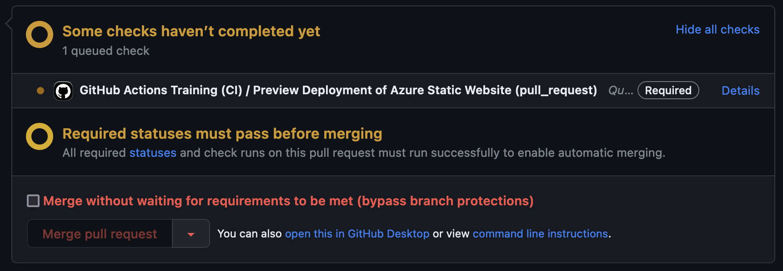
Lab 2 (create another PR)
Go to your github.com repo in your web browser and create a new PR against the “main” branch using your new branch
Make sure that you are requesting to merge your new branch into main
Create the PR
Notice that merging is now blocked until the Action completes successfully
Notes:
Introduce self
- Started as "AIP”: the Aggie Innovation Platform
- Our true goal was to reimagine and reinvent how enterprise IT was done at TAMU.
- And to influence the culture at TAMU to believe in processes with less toil, lower entropy, and higher efficiency.
- And we all really love robots.
For most of TAMU, we are the “service owner” of the Public Clouds.

Slide 24
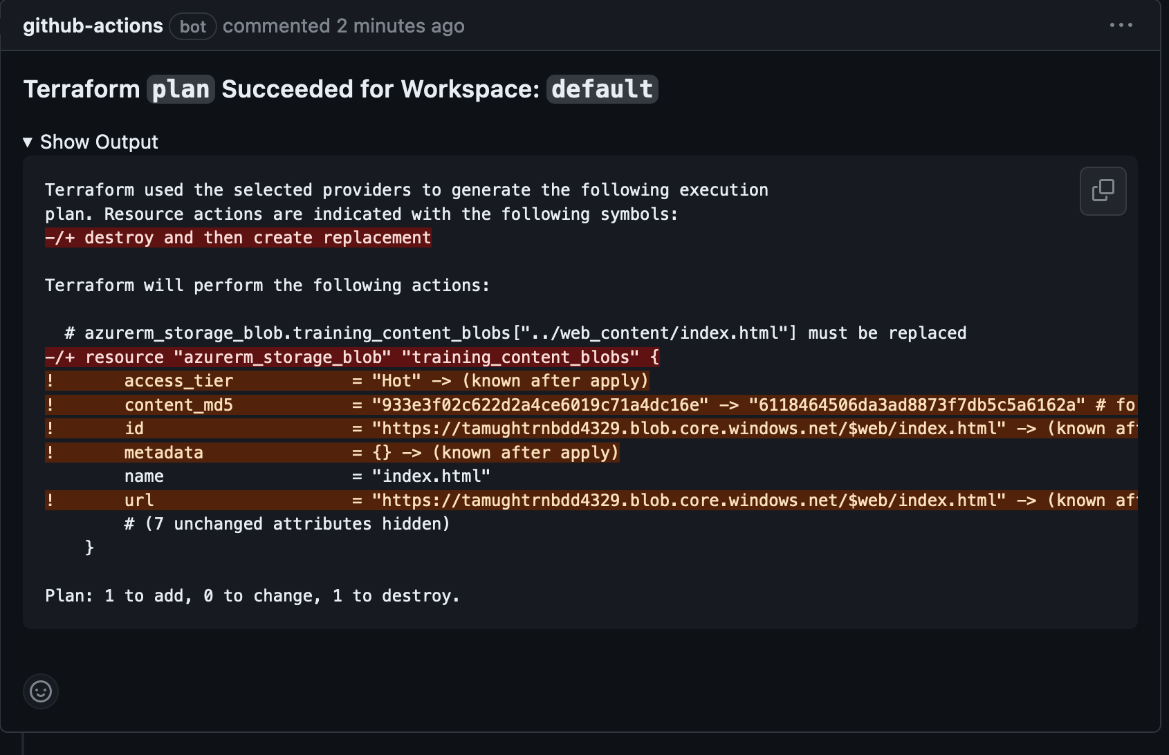
Lab 2 (create another PR)
Observe the PR comment and make sure that the proposed changes make sense
Notes:
Introduce self
- Started as "AIP”: the Aggie Innovation Platform
- Our true goal was to reimagine and reinvent how enterprise IT was done at TAMU.
- And to influence the culture at TAMU to believe in processes with less toil, lower entropy, and higher efficiency.
- And we all really love robots.
For most of TAMU, we are the “service owner” of the Public Clouds.

Slide 25
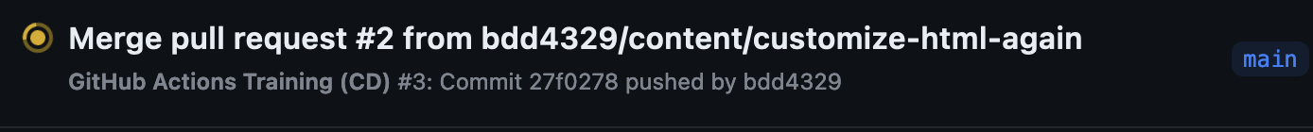
Lab 2 (merge the PR)
Merge the Pull Request
Investigate the Action run that deploys the site
Notes:
Introduce self
- Started as "AIP”: the Aggie Innovation Platform
- Our true goal was to reimagine and reinvent how enterprise IT was done at TAMU.
- And to influence the culture at TAMU to believe in processes with less toil, lower entropy, and higher efficiency.
- And we all really love robots.
For most of TAMU, we are the “service owner” of the Public Clouds.

Slide 26
Lab 2 (refresh your website)
Refresh your website and notice that the content has updated
Notes:
Introduce self
- Started as "AIP”: the Aggie Innovation Platform
- Our true goal was to reimagine and reinvent how enterprise IT was done at TAMU.
- And to influence the culture at TAMU to believe in processes with less toil, lower entropy, and higher efficiency.
- And we all really love robots.
For most of TAMU, we are the “service owner” of the Public Clouds.

